Slide 1
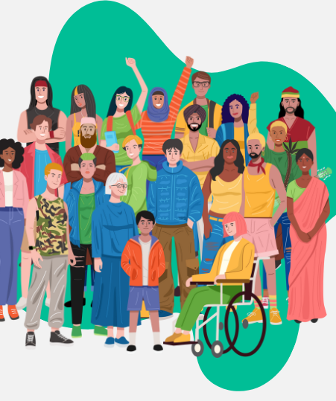
SOCIAL CHANGE
Ms. Kauser Malik
Lecturer (Sciences & Humanities)

Slide 2
Learning Outcomes
Definition of social change
Theoretical approaches to social change
Factors that play an important role in bringing about social change

Slide 3
Social Change
Also known as social progress or sociocultural evolution. Refers to fundamental alterations in the patterns of culture, structure, social institutions, and social behavior over time. The alteration of culture and societies over time.
Alterations that occur in the social structure and social relationship. Alterations may occur in norms, values, cultural products and symbols in a society. Or the transformation of culture and social institutions over time.

Slide 4
Process of Social Change
Four major characteristics:
Example:
1. A significant social change occurred in the form of drastic shift from an agricultural society to industrialized and post-modern society.
2. Change in family system.
3. Change in education system.
4. Globalization (media exchange, cultural variations)
Social change happens all the time.
Social change is sometimes intentional but often it is unplanned.
Social change is controversial.
Some changes matter more than others.

Slide 5

Is every kind of social change good?
Internet has changed socialization, human interaction, banking, shopping other modes of living etc.

Slide 6

Social Revolutions
The
When humans domesticated plants and animals - this first social revolution allowed hunting and gathering societies to develop into horticultural and pastoral societies.
The plow brought about the second social revolution, from which agricultural societies emerged.
The third social revolution, prompted by the invention of the steam engine, ushered in the Industrial Revolution.
Now we are in the midst of the fourth social revolution, stimulated by the invention of the microchip.
The process of change has accelerated so greatly that the mapping of the human genome system could be pushing us into yet another new type of society, one based on biotechnology.

Slide 7
From Gemeinschaft to Gesellschaft
Sociologists use the terms Gemeinschaft and Gesellschaft to indicate fundamental shift in society
Introduced by German sociologist Ferdinand Tönnies, Gemeinschaft and Gesellschaft are two conceptual models for types of human association.
Gemeinschaft, often translated as ”community “, is a concept referring to individuals bound together by common norms, often because of shared physical space and shared beliefs.
Gesellschaft, often translated as ”society”, refers to associations in which self-interest is the primary justification for membership. Or people who live and work very close together in proximity but very far apart relationally.

Slide 8
Contrasting Societies
Simple vs Complex Societies
Gemeinschaft
Gemeinschaft, societies are small, rural, and slow-changing.
Members of society are close
Activities center on the family and community
Strong group solidarity
Men dominate social life, and the divisions of labor between men and women are rigid.
People live in extended families, have little formal education, treat illness at home, tend to see morals in absolute terms, and consider the past the key for dealing with the present.
Examples: preindustrial societies or rural villages
Gesellschaft
Modern, or Gesellschaft, societies are large, urbanized, and fast-changing, with more fluid divisions of labor between the sexes.
People have smaller families and low rates of infant mortality.
They prize formal education, are future-oriented, have higher incomes, and enjoy vastly more material possessions.
Social relationships are based on need rather than emotion, are impersonal, often temporary
Traditional values weak
Individual goals more important than group’s

Slide 9
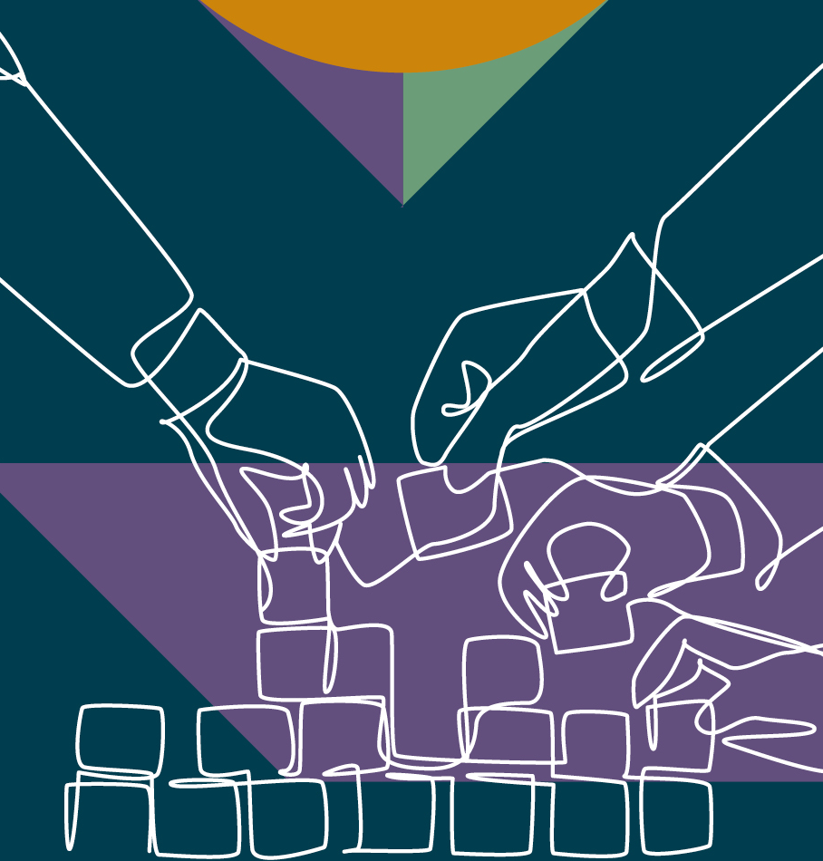
Nature of Social Change
It is universal
Continuous process
Influenced by time
Must be viewed objectively
Differs from one society to another
Covers the whole community
Modification/replacement are key factors

Slide 10
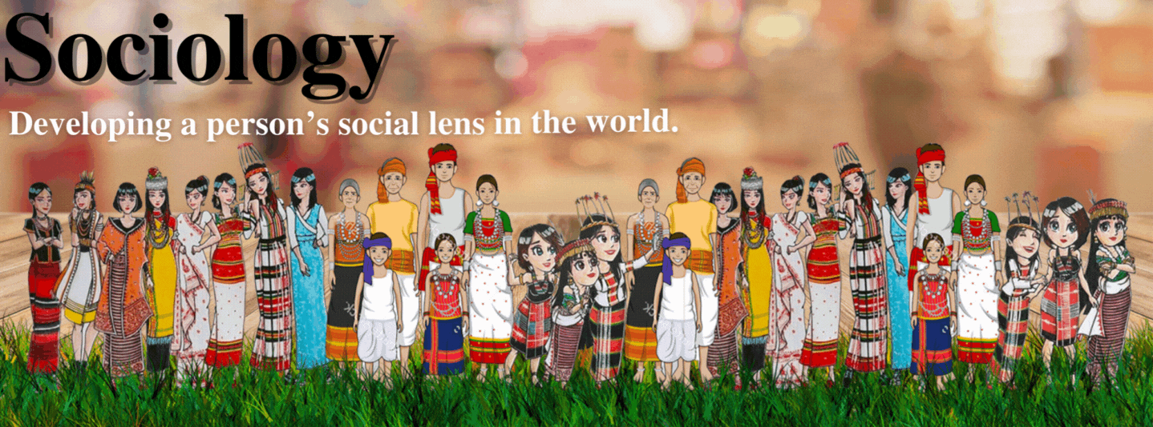
Main Theories About Social Change:
Cyclical theories
Evolutionary Theories
Conflict theories
Functional theories

Slide 11
1. Evolutionary Theories
During the 19th century the evolutionary perspective became dominant to understand the process of social change. Auguste Comte, Morgan, and Spencer were the major proponents of this theory. They believed that society is the outcome of the constant process of evolution.
It starts with a simple beginning to a more complex form. Evolutionary theorists consider social change in a positive sense. According to them, social change meant “progress” towards something better.
The theory was highly influenced by Darwin’s theory of organic evolution. The Darwinian model of biological evolution was applied by the evolutionary theorists who considered society as an organism to understand social evolution.

Slide 12
2. Cyclical theories
The basic premise of the cyclical theories is: cultures and civilisations pass through stages of change, starting and often ending with the same stage. This passing through stages is called a cycle. The cycle when completed, repeats itself over and over again. Sorokin, Toynbee, Spengler are the major theorists of this school of thought of social change.
The cyclical theory of social change focuses on the rise and fall of civilizations and attempts to discover the patterns of growth and decay. It focuses on the fact that civilization have always risen and fallen. Like an organism, all civilizations have a life-like birth, maturity, old age and death.
Oswald Spengler (1945) believed that every society is born, matures, decays and eventually dies. He has criticized the evolutional theories of social change and said that change never happens in a straight line. In view of Spengler, social change occurs in a cycle, from where we start after roaming, we again reach the same place. He believed that social change may take the form of progress or of decay, but that no society lives for ever.
Example: The Roman Empire rose to power and then gradually collapsed. The British empire grew strong, and then deteriorated.

Slide 13
3. Conflict Theories
Conflict theory views social conflict as the constant, and change as the result of this conflict. Since conflict is continuous, change is continuous. Change produces new interest groupings and classes, and conflict between these produces further change.
Any particular change represents the success of victorious groups or classes in imposing their preferences upon others. A number of social theorists have espoused this approach such as Karl Marx, Lewis Coser, and Ralf Dahrendorf.
Marx and other conflict theorists deem society as basically dynamic and not static. They consider conflict as a normal, not an abnormal process.
According to the conflict perspective, society is constantly in conflict over resources, and that conflict drives social change.
Conflict theorists do not assume that societies smoothly evolve to higher or complex levels. According to this school every pattern of action, belief and interaction tends to generate an opposing reaction.
E.g., the legalisation of abortion has provoked the anti-abortion movement. The feminist movement has stimulated a reaction from men and women.
The basic premise is that one of the outcomes of conflict among groups is social change.

Slide 14
Ogburn’s Theory
Sociologist William Ogburn (1922/1950, 1961, 1964) proposed a theory of social change that is based largely on technology. He said that technology changes society by three processes:
invention,
discovery, and
diffusion

Slide 15
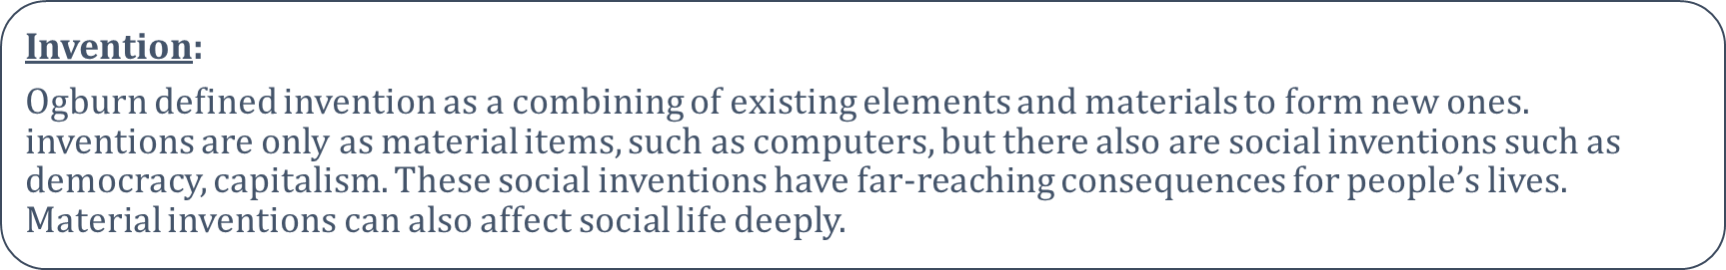
Discovery:
Ogburn identified discovery, a new way of seeing reality, as a second process of change. The reality is already present, but people see it for the first time. An example is Columbus’s “discovery” of North America, which had consequences so huge that they altered the course of human history.
Diffusion:
Ogburn stressed how diffusion, the spread of an invention or discovery from one area to another, can deeply affect people’s lives. E.g., the axe. When missionaries introduced steel axes to the Aborigines of Australia, it upset their whole society. Before this, the men controlled axe-making. They used a special stone that was available only in a remote region, and fathers passed axe-making skills on to their sons. Women had to request permission to use the axe. When steel axes became common, women also possessed them, and the men lost both status and power (Sharp 1995).
Diffusion also includes the spread of social inventions and ideas. The idea of citizenship changed political structures around the world. It swept away monarchs as an unquestioned source of authority. The idea of gender equality is now circling the globe. Like citizenship, gender equality is destined to transform human relationships and entire societies.

Slide 16
Cultural Lag
The term ‘cultural lag’ is often used to describe the state of disequilibrium between material and non-material aspects of a culture. Ogburn (1886-1959) who coined this word, explained that ‘cultural lag’ occurs when parts of a culture that were once in adjustment with each other change at different rates, and become incompatible with each other.
He pointed out how the non-material culture (values, beliefs, norms, family, religion) often lags behind material culture (technology, means of production output of the economic system).
For example, family planning technologies (i.e. material culture) have advanced, but people take their time to accept them. Some sections of the population may reject the very idea of ‘family planning’ and believe in having a large family.
When an event such as increase in population or a depletion in natural resources cause a strain in society, it takes some time for the society to understand and absorb the strain and alter its values and institutions to adapt to the change. But in order to function smoothly, societies adjust to maintain and restore themselves.

Slide 17
4. Functional Theories
In the middle decades of the 20th century a number of American sociologists shifted their attention from social dynamics to social statics or from social change to social stability.
Structural functionalists believe that society, like the human body, is a balanced system. Each institution serves a function in maintaining society. When events outside or inside the society, disrupt the social order, social institutions make adjustments to restore stability. Functionalists accept change as a constant which does not need to be “explained.”
Changes disrupt the equilibrium of a society, until the change has been integrated into the culture. Changes which prove to be useful (functional) are accepted and those which are useless or dysfunctional are rejected.
The functionalist theory of social change teaches that society is like a human body. Each part is like an organ. Individual parts can't survive on their own. Emile Durkheim, a major leader in the social sciences, believed that all parts of a society must be harmonious.
Example: the government provides education for the children of the family, which in turn pays taxes on which the state depends to keep itself running.

Slide 18
Factors Influencing Social Change
1. Natural Factors
2. Cultural Factors
3. Science and Technology Factors/ Globalization
4. Biological Factors
5. Demographic Factors

Slide 19

1. Natural Factors:
A storm, earthquake, flood, drought, disease and similar natural events even today can disrupt the social system.
Natural calamities like floods, earthquakes, draughts, famines and other natural disasters always force changes in the social conditions and life of the affected people.

Slide 20

2. Cultural Factors:
The cultural factors also play a role in bringing about social change. Our social life depends upon our beliefs, ideas, values, customs, conventions, institutions and the like. When there is a change in these, it influences the social life.
For example, the system of marriage. The relations between the parents and children have undergone a big change. The new love and need for working couples has acted as a source of big change in family relations and culture. Thus, socio-economic and cultural factors always act as big and formidable factors of social change

Slide 21

3. Science and Technology factors:
In contemporary times science and technology happens to be the most important factor of social change. New scientific inventions and technologies always greatly influence the social life.
Technology brings about changes in the physical environment and the material culture of each society which in turn gives birth to social change.

Slide 22
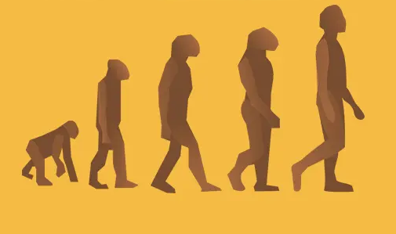
4. Biological Factors:
Biological factors also affect social change. Biological factors are those factors which determine the structure, selection and hereditary qualities of generations.
The human element is ever changing. Each new generation is different from previous generation.
It is different in form, ideas and in many other ways from the one gone before.

Slide 23

5. Demographic Factors:
The Demographic factors always influence the process and nature of Social Change. The population increase or decrease always brings social problems. When the birth-rate in a society exceeds death-rate, population begins to rise.
A constantly rising population gives birth to poverty, unemployment, disease and several other related problems.
On the other hand, a low birth-rate means leads to decrease in the size of the population. When population is low, there are fewer skilled hands available and the country cannot make full use of the natural resources.
The social conditions deteriorate the size of families shrink and it affects the social relations.

